Slide 1
Cornerstone City Church Peninsula Plus Community Hoo Are Ya 26-03-2023

Slide 2
Blessed be the name of the Lord
Clinton Utterbach
Words and Music: (c) 1988, 19898 Polygram Music Publishing Ltd

Slide 3
1/4
Blessed be the name of the Lord
Blessed be the name of the Lord
Blessed be the name of the Lord, Most High. (Repeat)

Slide 4
2/4
The name of the Lord is a strong tower
The righteous run into it and they are saved (REPEAT)

Slide 5
3/4
Glory to the name of the Lord Glory to the name of the Lord Glory to the name of the Lord, Most High. (Repeat)

Slide 6
4/4
Holy is the name of the Lord
Holy is the name of the Lord
Holy is the name of the Lord, Most High. (Repeat)

Slide 7
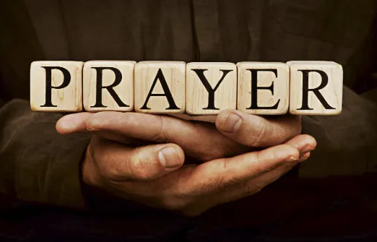

Slide 8
The Power Of The Cross
CCLI Song # 4490766
Keith Getty | Stuart Townend
© 2005 Thankyou Music (Admin. by Integrity Music Ltd)
For use solely with the SongSelect® Terms of Use. All rights reserved. www.ccli.com
CCLI Licence No. 33265

Slide 9
1/6
Oh to see the dawn of the darkest day
Christ on the road to Calvary
Tried by sinful men torn and beaten then
Nailed to a cross of wood

Slide 10
2/6
This the pow'r of the cross
Christ became sin for us
Took the blame bore the wrath
We stand forgiven at the cross

Slide 11
3/6
Oh to see the pain written on Your face
Bearing the awesome weight of sin
Ev'ry bitter thought ev'ry evil deed
Crowning Your bloodstained brow

Slide 12
4/6
Now the daylight flees now the ground beneath
Quakes as its Maker bows His head
Curtain torn in two dead are raised to life
Finished the vict'ry cry

Slide 13
5/6
Oh to see my name written in the wounds
For through Your suff'ring I am free
Death is crushed to death life is mine to live
Won through Your selfless love

Slide 14
6/6
This the pow'r of the cross
Son of God slain for us
What a love what a cost
We stand forgiven at the cross

Slide 16
Holy Forever
CCLI Song # 7201044
Brian Johnson | Chris Tomlin | Jason Ingram | Jenn Johnson | Phil Wickham
© Phil Wickham Music (Admin. by / Small Stone Media BV, Holland (Admin. in the UK/Eire by Song Solutions www.songsolutions.org))
Simply Global Songs (Admin. by / Small Stone Media BV, Holland (Admin. in the UK/Eire by Song Solutions www.songsolutions.org))
Capitol CMG Paragon (Admin. by Capitol CMG Publishing)
S. D. G. Publishing (Admin. by Capitol CMG Publishing)
Be Essential Songs (Admin. by Essential Music Publishing LLC)
My Magnolia Music (Admin. by Essential Music Publishing LLC)
Bethel Music Publishing (Admin. by Song Solutions)
Brian and Jenn Publishing (Admin. by Song Solutions)
For use solely with the SongSelect® Terms of Use. All rights reserved. www.ccli.com
CCLI Licence No. 33265

Slide 17
1/6
A thousand generations falling down in worship
To sing the song of ages to the Lamb
And all who've gone before us
And all who will believe
Will sing the song of ages to the Lamb

Slide 18
2/6
(Jesus) Your name is the highest
Your name is the greatest
Your name stands above them all
All thrones and dominions
All powers and positions
Your name stands above them all

Slide 19
3/6
And the angels cry Holy
All creation cries Holy
You are lifted high Holy
Holy forever

Slide 20
4/6
Hear Your people sing Holy
To the King of Kings Holy
You will always be Holy
Holy forever

Slide 21
5/6
If you've been forgiven and if you've been redeemed
Sing the song forever to the Lamb
If you walk in freedom and if you bear His name
Sing the song forever to the Lamb
We'll sing the song forever and amen

Slide 22
6/6
You will always be Holy
Holy forever

Slide 24
Goodness Of God
CCLI Song # 7117726
Ben Fielding | Brian Johnson | Ed Cash | Jason Ingram | Jenn Johnson
© 2018 Capitol CMG Paragon (Admin. by Capitol CMG Publishing)
Fellow Ships Music (Admin. by Essential Music Publishing LLC)
So Essential Tunes (Admin. by Essential Music Publishing LLC)
SHOUT! Music Publishing Australia (Admin. by SHOUT! Music Publishing UK)
Bethel Music Publishing (Admin. by Song Solutions)
For use solely with the SongSelect® Terms of Use. All rights reserved. www.ccli.com
CCLI Licence No. 33265

Slide 25
1/4
I love You Lord
Oh Your mercy never fails me
All my days
I've been held in Your hands
From the moment that I wake up
Until I lay my head
I will sing of the goodness of God

Slide 26
2/4
All my life You have been faithful
All my life You have been so so good
With every breath that I am able
I will sing of the goodness of God

Slide 27
3/4
I love Your voice
You have led me through the fire
In darkest night
You are close like no other
I've known You as a father
I've known You as a friend
I have lived in the goodness of God

Slide 28
4/4
Your goodness is running after
It’s running after me
Your goodness is running after
It’s running after me
With my life laid down
I’m surrendered now
I give You everything
Your goodness is running after
It's running after me

Slide 30


Slide 31
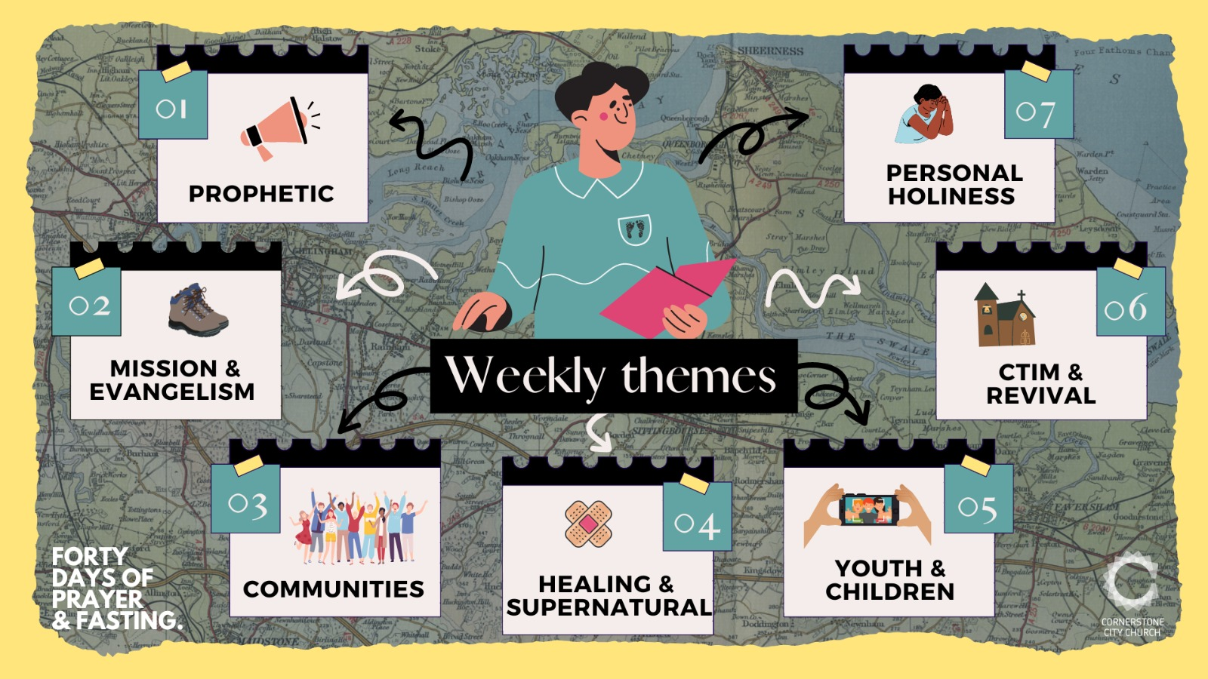

Slide 32
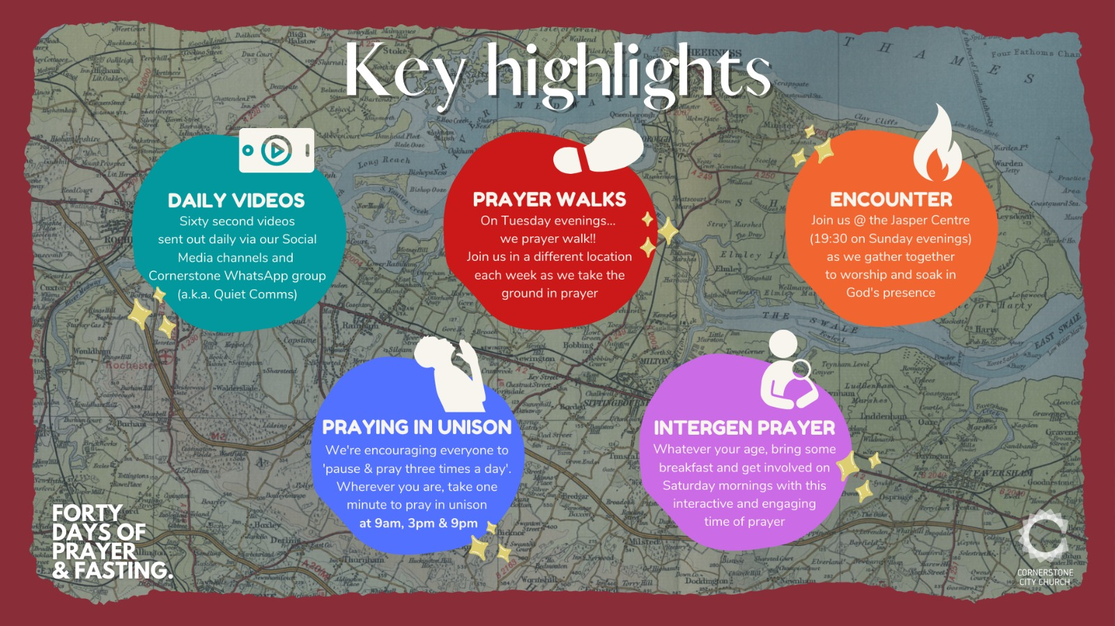

Slide 33
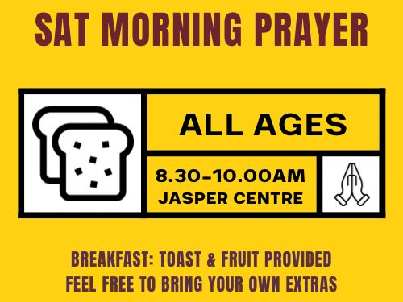

Slide 34
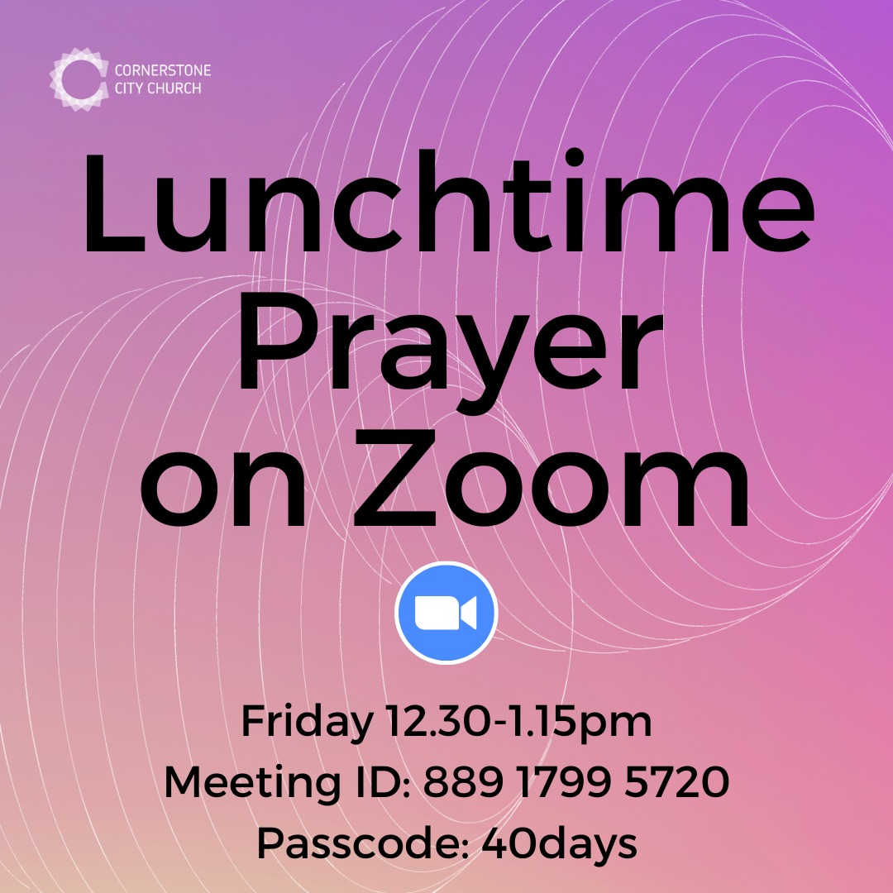

Slide 35


Slide 36


Slide 37

Notes:
Save the dates
Mums and dads, carers and grandparents - you are invited to join Susie, Tom and Jasmine on a Parenting for Faith course.
Parenting is so overwhelming sometimes isn't it? (Or is it just me?! 😅)
We so want our children to grow up knowing and loving God. Let's come together to seek our Father's help and learn from each other along the way.
There will be a couple of in person sessions, and some over Zoom, because we want to make it as accessible as possible.Special plea to Dads - I'd love your company too if you can make it!
Watch the video for more info 👆🏻
Contact Susie (susie@cornerstonecity.co.uk) or Tom (tom@cornerstonecity.co.uk) to find out more.

Slide 38


Slide 39


Slide 40
